Slide 1
Flow in the unsaturated zone
Capillary pressure & suction curves
Richards equation, K-θ relationships
Back to saturated flow: specific yield
Mechanisms of runoff production
Issues: spatial variability, preferential flow, hysteresis
Hydroprotech - Nice Risques hydrologiques V. Guinot (IHE)

Slide 2

Capillary pressure
Forces induced by surface tension at the interface between phases
Air p_{atm}
Soil grain
Water
p < p_{atm}
Soil grain
Hydroprotech - Nice Risques hydrologiques V. Guinot (IHE)

Slide 3
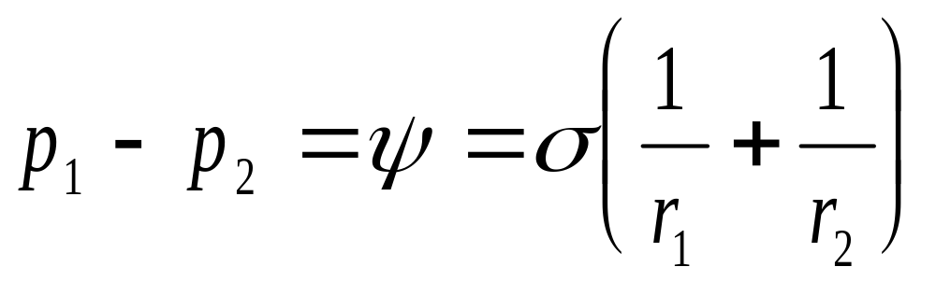
Capillary pressure (2)
Laplace’s law
r₁
r₂
Air
p₁
Water
p₂
Hydroprotech - Nice Risques hydrologiques V. Guinot (IHE)

Slide 4
Capillary pressure (3)
High water content : large radius : small ψ
Low water content : small radius : large ψ
Hydroprotech - Nice Risques hydrologiques V. Guinot (IHE)

Slide 5
The suction curve
High water content : large radius : small ψ
Low water content : small radius : large ψ
ψ
Water content
θ
Hydroprotech - Nice Risques hydrologiques V. Guinot (IHE)

Slide 6
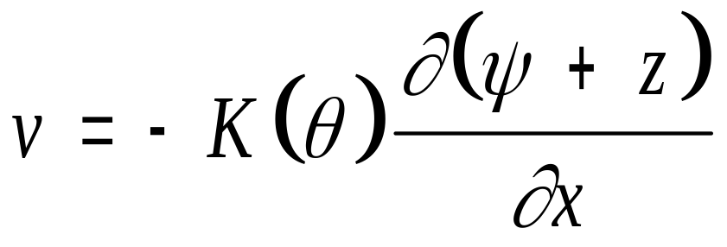
Richard’s equation, K-θ
Water content decreases => thinner liquid film => more head loss => lower hydraulic conductivity
K
K_{s}
θ_{s}
θ
Hydroprotech - Nice Risques hydrologiques V. Guinot (IHE)

Slide 7
Saturated zone & specific yield
Specific yield: Sy = dh/dR
dh = rise in the water table due to an elementary recharge dR
Sy
Sy
dh
Aquifer
Aquifer
Hydroprotech - Nice Risques hydrologiques V. Guinot (IHE)

Slide 8
Runoff production
Horton : the rainfall intensity exceeds the soil infiltration capacity
Dunne : a long period of moderate rainfall causes the water table to rise up to the ground surface
Horton
Dunne
Hydroprotech - Nice Risques hydrologiques V. Guinot (IHE)

Slide 9
Issues - themes for research
Spatial variability : K_{s} may vary easily by a factor of 10 over distances of 10 - 50 m => what is a ‘representative’ K ?
Preferential flow in the unsaturated zone (cracks, root paths, wormholes !) => Darcy/Richards not valid (double porosity models)
Hysteretical behaviour: the ψ-θ relationship is non-unique.
Hydroprotech - Nice Risques hydrologiques V. Guinot (IHE)

